Slide 1
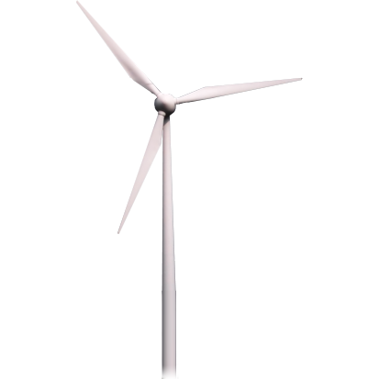
Predicting Wind Turbine Power Performance
Stephanie Sheldon
Jason Cotrell
Jay Buntemeyer

Slide 2
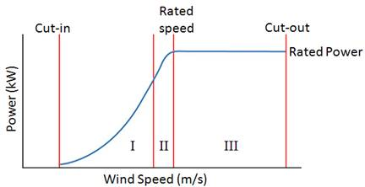
The Power Curve

Slide 3
Objectives and Approach
Develop models to better predict power for a 1500 kW wind turbine
Conventional Method: Binning of power per wind speed
Multiple Linear Regressions: Entire data set, piecewise and transformed
Ensemble and other: Random Forest, Bagging, Boosting, Cubist

Slide 4

Available Data
Simulated data from a 1500 kW wind turbine
Variables: Wind speed, turbulence, shear, rotor-equivalent wind speed, and velocity profile metric (RSS)
Output was average power (kW) and standard deviation of that average power over a 10-minute period

Slide 5
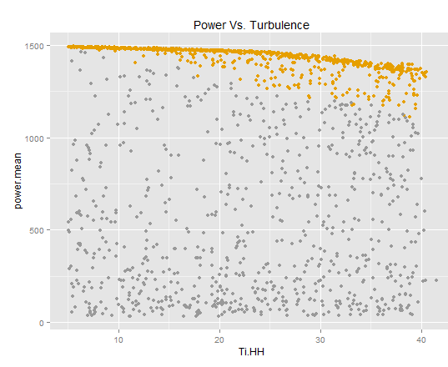
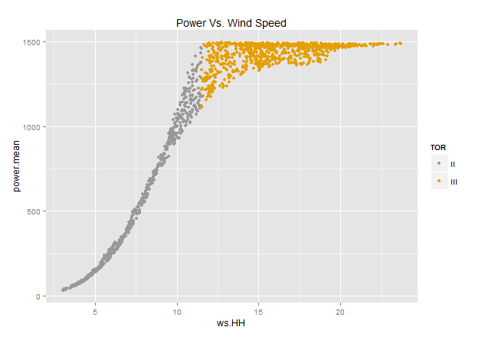
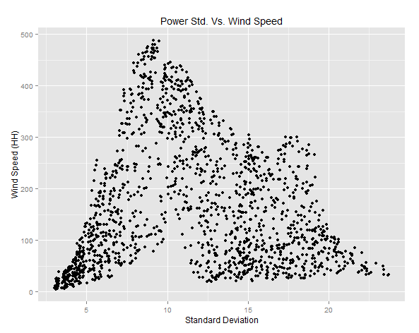
Key EDA Observations

Slide 6
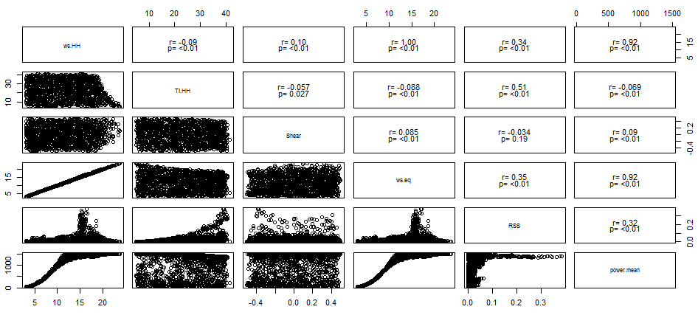
Correlation Matrix

Slide 7
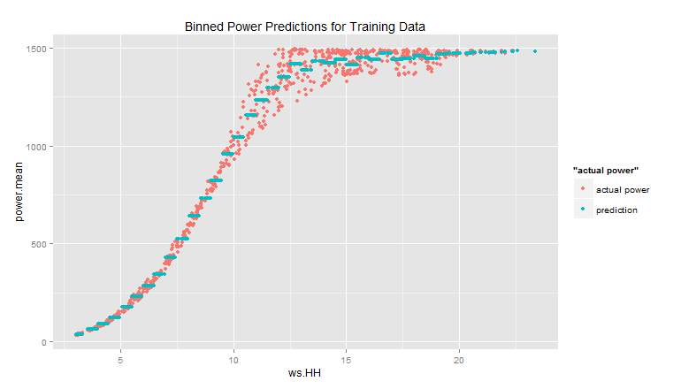
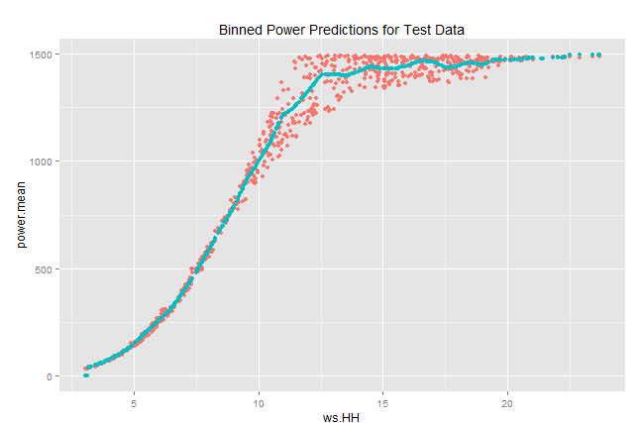
Binned & Interpolated Models
MSE Training Data = 2404
MSE Test Data = 2982
MSE Training Data = 2166 (90%)
MSE Test Data = 2676 (90%)

Slide 8
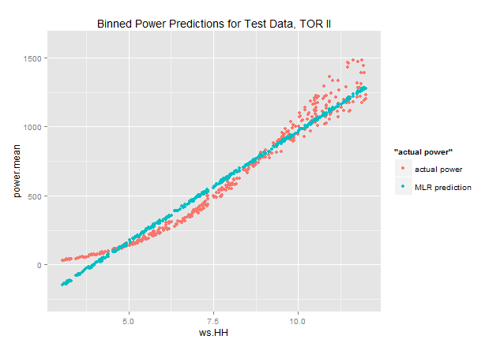
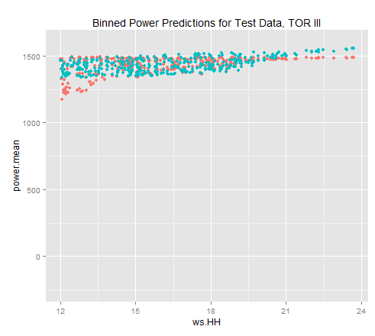
MLR Piecewise Model
MSE Test Data = 1234
MSE Test Data = 6546
Total MSE Test Data = 7690 (256%)

Slide 9
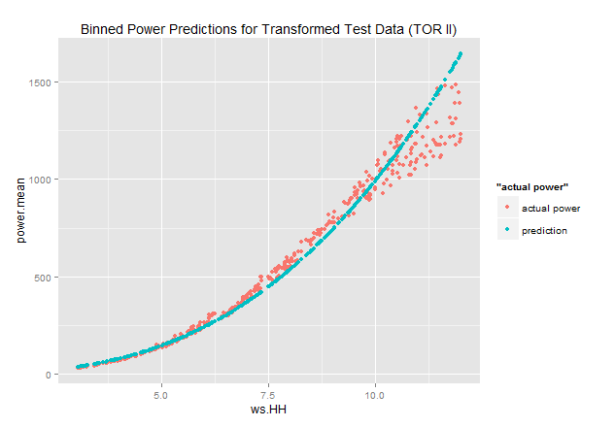
Transformed LR Model (TOR II)
MSE Test Data = 8961
Total MSE Test Data = 10,195 (350%)

Slide 10
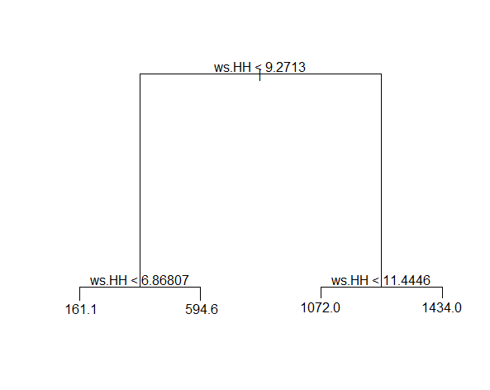
Tree Model
Final values:
4 variables in model
1 variable (ws.HH ) used
in construction
Train MSE = 9,418
Test MSE = 9,776

Slide 11
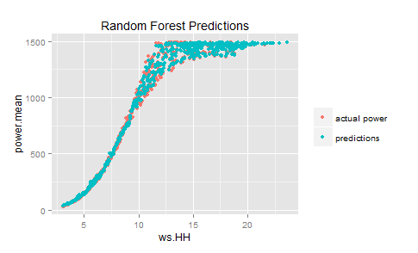
Random Forest
Final values:
mtry = 3
Train MSE = 205.327
Test MSE = 256.756

Slide 12
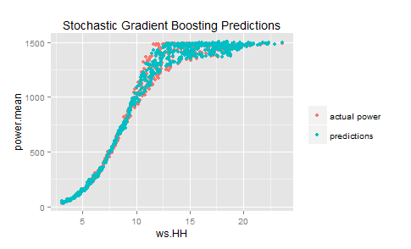
Stochastic Gradient Boosting
Final values:
n.trees = 150
interaction.depth = 3
shrinkage = 0.1
n.minobsinnode = 10
Train MSE = 284.218
Test MSE = 342.370

Slide 13
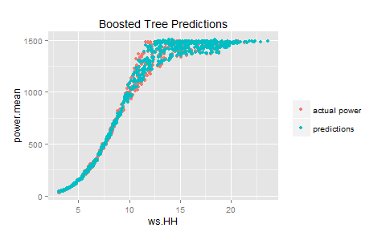
Boosted Tree
Final values:
mstop = 150
maxdepth = 3
nu = 0.1.
Train MSE = 177.713
Test MSE = 241.578

Slide 14
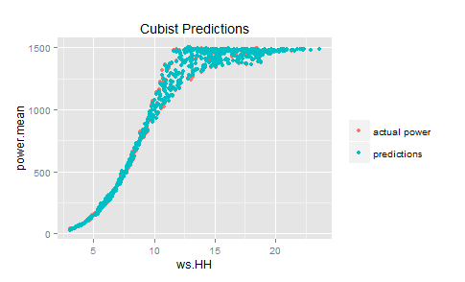
Cubist
Final values:
committees = 20
neighbors = 5
Train MSE = 31.886
Test MSE = 25.885

Slide 15
Model Conclusion
Model | Training MSE | Testing MSE | % of Binned Model
Binning | 2404 | 2982 | 100%
Interpolating Bins | 2166 | 2176 | 73%
Piecewise MLR | - | 7690 | 258%
Piecewise MLR Transformed | - | 10,195 | 342%
Simple Tree | 9418 | 9776 | 328%
Random Forest | 205 | 257 | 9%
Stochastic Gradient Boosting | 284 | 342 | 11%
Boosted Tree | 178 | 242 | 8%
Cubist (BEST) | 32 | 26 | 1%

